Slide 1

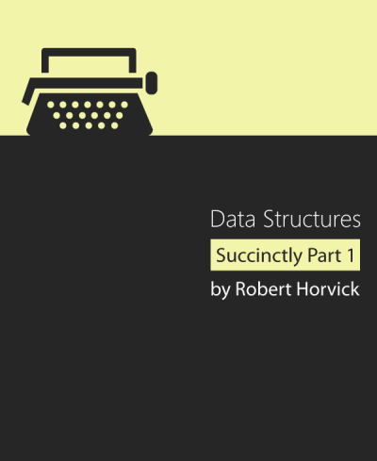
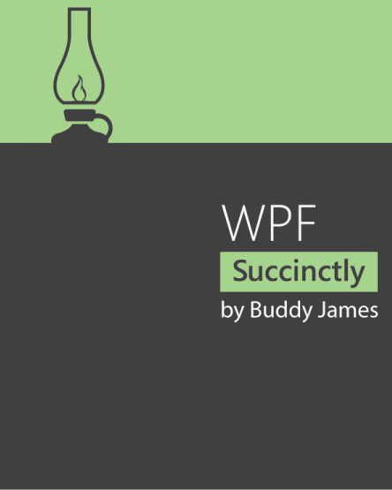
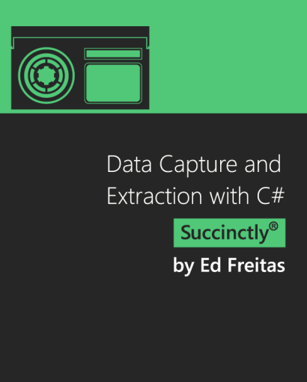
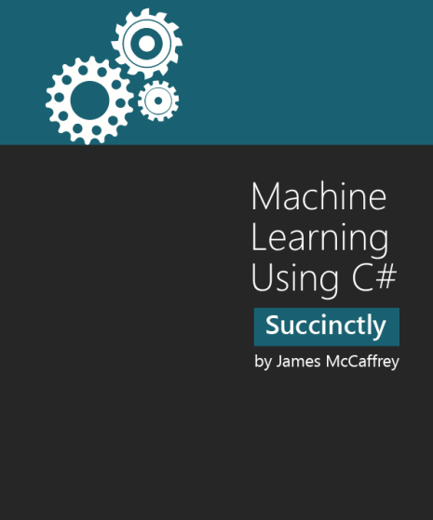
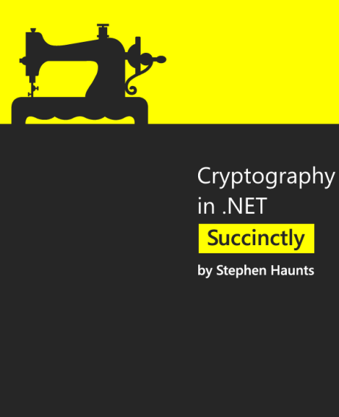
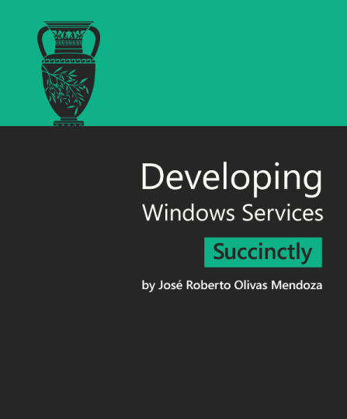
Topic 5

Slide 2
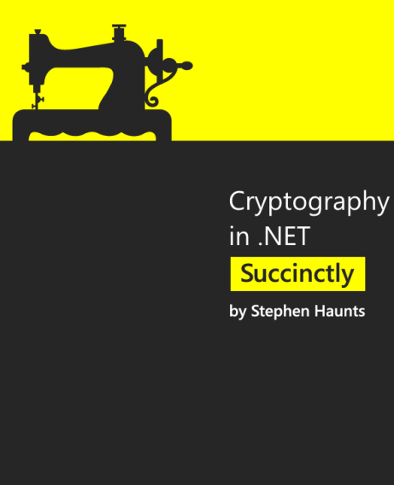
CRYPTOGRAPHY

Slide 3
Introducing
Cryptography is the art of protecting information by transforming it into an unreadable format called ciphertext. Only those who possess a secret key can decipher (or decrypt) the message into plaintext.
There are three main security themes that are covered by cryptography:
+ Confidentiality
+ Integrity
+ Nonrepudiation
.NET comes with a rich collection of cryptography objects that you can use to help provide better security in your applications. The cryptography objects in .NET all live within the System.Security.Cryptography namespace.

Slide 4
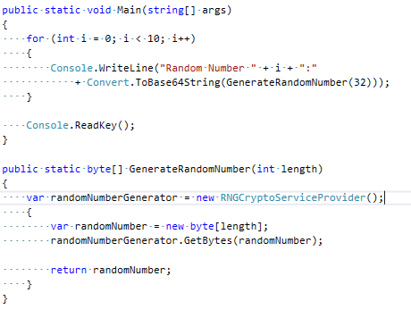
Cryptographic Random Numbers
Random numbers are important in cryptography as you need them for generating encryption keys.

Slide 5
Hashing Algorithms
There are various algorithms you can use such as MD5, SHA-1, SHA-256, and SHA-512.

Slide 6
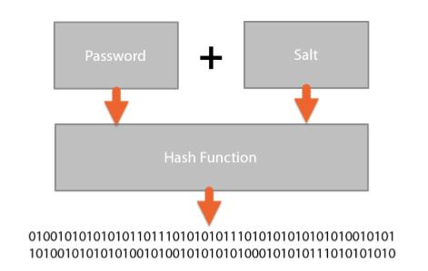
Password Storage
Using Hashes to Store Passwords
To increase the entropy of the password being attacked by making the password harder to recover. This can be done by adding a salt onto the password before hashing.

Slide 7
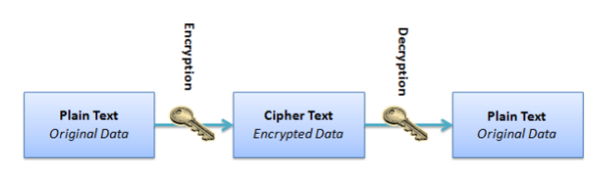
Symmetric Encryption
A symmetric encryption algorithm is a two-way encryption process that uses the same key for both encryption and decryption of your message. In theory, this sounds straightforward as both the sender and receiver of the message should know the key, but in practice securely sharing a key is very hard to do.

Slide 8
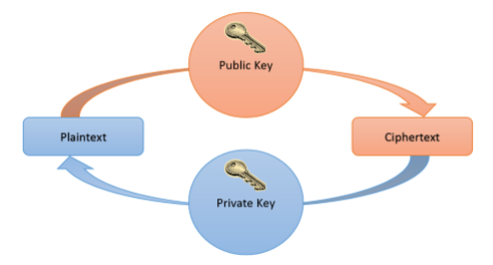
Asymmetric Encryption
The main problem with symmetric encryption is that of securely sharing keys. A good solution to this problem is to use asymmetric cryptography, which is also referred to as public key cryptography.

Slide 9
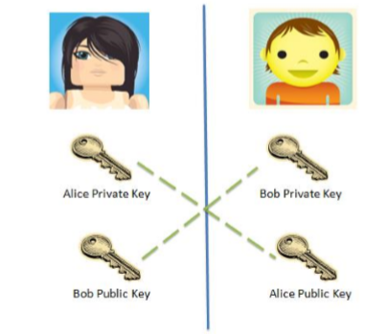
Hybrid Approach (RSA+AES)
This is where you use a combination of both RSA and AES.
Encryption
Alice generates a 256-bit (32-byte) AES Key. This key is called a session key in this process.
Alice generates a 128-bit (16-byte) IV.
Alice encrypts the data with AES using the session key and the IV.
Alice encrypts the session key with RSA and Bob’s public key.
Alice stores the encrypted data, encrypted AES session key, and IV in a separate structure or file. This is the packet of data that is sent to Bob
Decryption
Bob decrypts the encrypted AES session key by using RSA and Bob’s private key.
Bob decrypts the encrypted data by using the decrypted AES session key and the IV.
Bob reads the decrypted message.

Slide 10
Digital Signatures
An important function of cryptography is to ensure nonrepudiation of a sent message. This is where the receiver of the message cannot deny that the message is authentic. A digital signature is a technique used to help demonstrate this authenticity and the integrity of the message. Digital signatures are useful for demonstrating authenticity of documents and contracts, software downloads, and financial transactions.

Slide 11
Digital Signatures
A digital signature consists of the following three algorithms:
Public and private key generation using RSA.
A signing algorithm that uses the private key to create the signature.
A signature verification algorithm that uses the public key to test if the message is authentic.

Slide 12
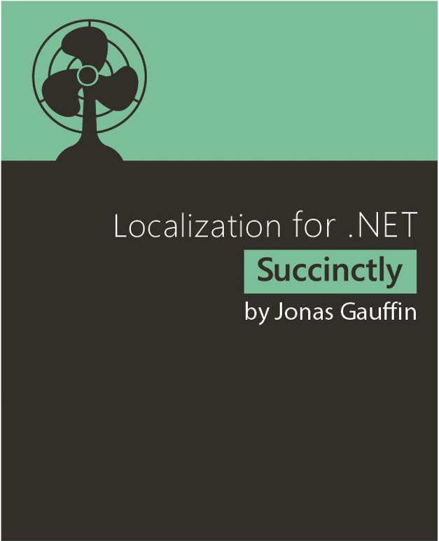
LOCALIZATION

Slide 13
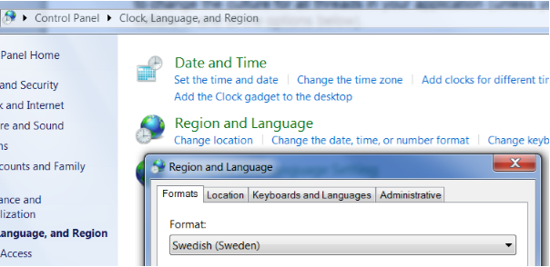
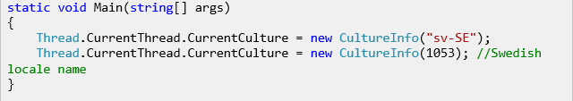
Start with Localization
The Formatting Culture.

Slide 14
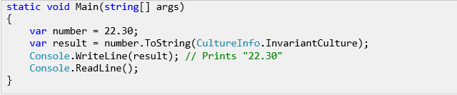

Start with Localization
Formatting using the invariant culture.
RegionInfo.

Slide 15
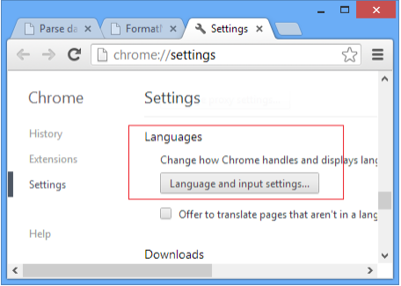
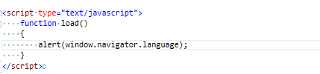
Start with Localization
Discovering the culture.

Slide 16
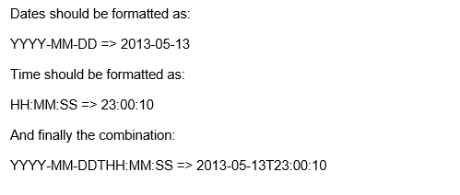
Date and Time
Standard format:
There is an ISO standard that specifies how date and time should be formatted. The standard is called ISO8601.

Slide 17
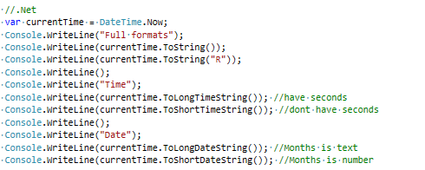

Date and Time
.NET
Formatting by culture

Slide 18
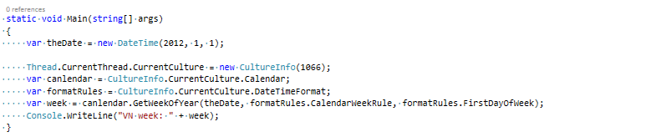
Time Zones
.NET

Slide 19
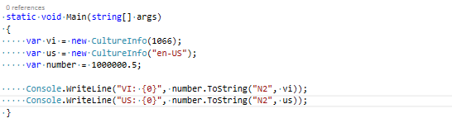
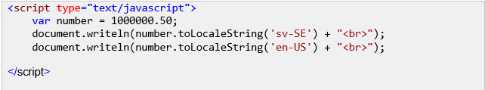
Number
.NET
JavaScript

Slide 20
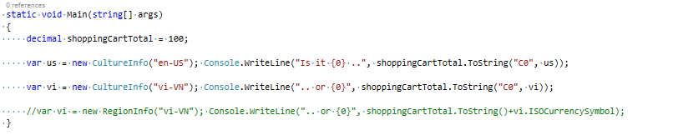
Currency/Money
.Net

Slide 21


Machine Learning

Slide 22

Machine learning . What is it ?
Machine learning is the subfield of
computer science that "gives computers the ability to learn without being explicitly programmed"
Using algorithms that iteratively learn from data, machine learning allows computers to find hidden insights without being explicitly programmed where to look.

Slide 23
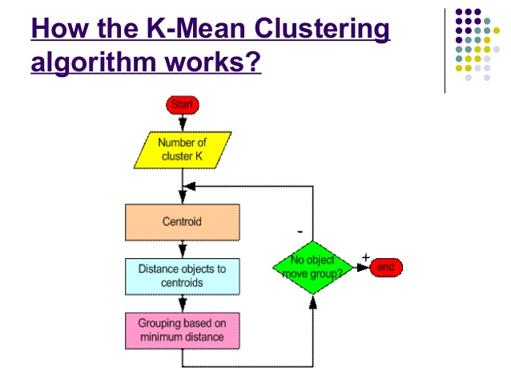
Chapter 1 : k-Means Clustering
Step 1 : Begin with a decision on the value of k = number of clusters.
Step 2 : Put any initial partition that classifies the data into k clusters. You may assign the trainning samples randomly, or systematically as the following :
Take the first k training sample as single-element clusters
Assign each of the remaining (N-k) trainning sample to the cluster with the nearest centroid. After each assignment, recompute the centroid of the gaining cluster.

Slide 24
Chapter 1 : k-Means Clustering
Step 3 : Take each sample in sequence and compute its distance from the centroid of each of the clusters. If a sample isn’t currently in the cluster with the closest centroid, switch this sample to that cluster and update the centroid of the cluster gaining the new sample and the cluster losing the sample.
Step 4 : Repeat step 3 until convergence is achieved, that is until a pass through the training sample causes no new assignments

Slide 25
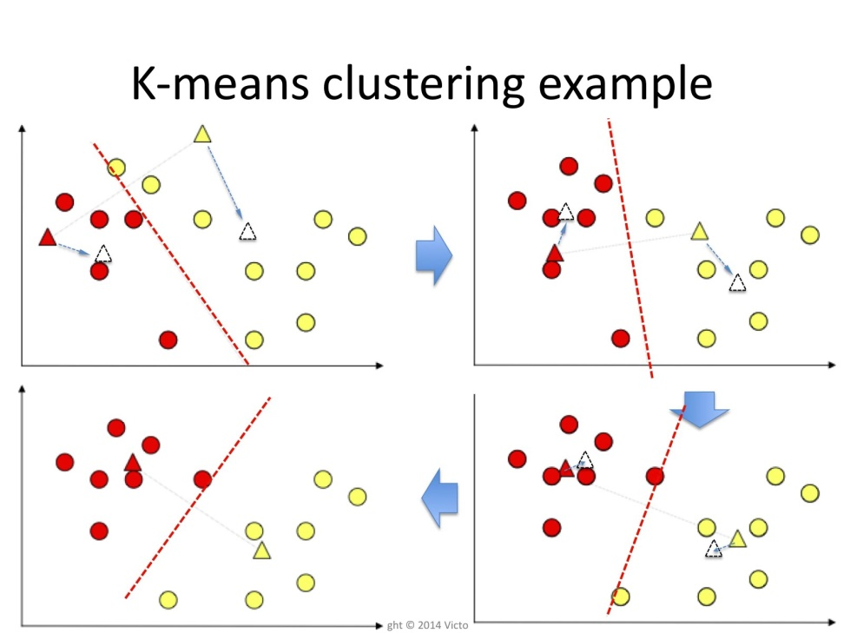
Chapter 1 : k-Means Clustering
The k-means alorithm

Slide 26
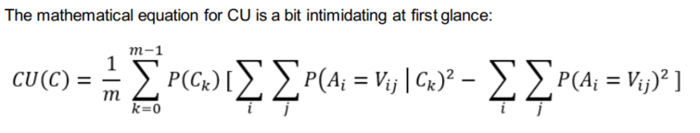
Chapter 2 : Categorical Data Clustering
CU (Categorical Utility) is a measure of "category goodness" defined in Gluck & Corter (1985) and Corter & Gluck (1992).
It attempts to maximize both the probability that two objects in the same category have attribute values in common, and the probability that objects from different categories have different attribute values.

Slide 27
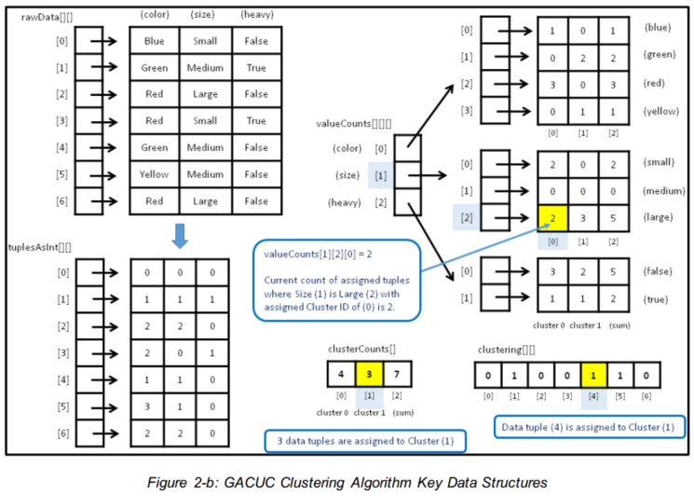
Chapter 2 : Categorical Data Clustering
The Key Data Structures
The important data structures for the GACUC categorical data clustering program are illustrated in Figure 2-b.

Slide 28
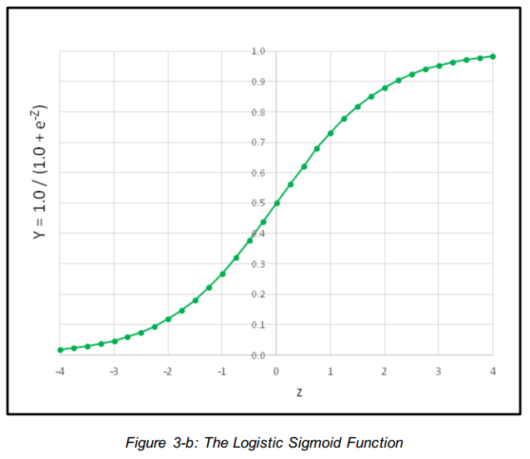
Chapter 3 : Logistic Regressing Classification
The logistic sigmoid function can accept any Z-value from negative infinity to positive infinity, but the output is always a value between 0 and 1, as shown in Figure 3-b.

Slide 29
Chapter 3 : Logistic Regressing Classification
Data Normalization
In theory, when performing logistic regression classification, it's not necessary to normalize your data. But in practice normalization usually helps to create a good prediction model. There are two main types of normalization, called Gaussian and min-max. The demo uses Gaussian normalization, sometimes called z-score normalization (where z is not the same as the intermediate logistic regression Z value in the previous section).
Creating Training and Test Data
One approach to creating a logistic regression classification model is to simply train the model using all available data. However, it's better in most situations to hold out some of the data so that the model can be evaluated to give an estimate of its accuracy when presented with new, previously unseen data.

Slide 30
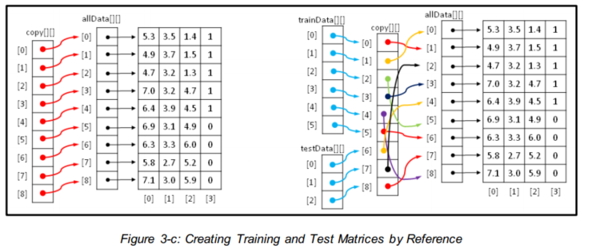
Chapter 3 : Logistic Regressing Classification

Slide 31
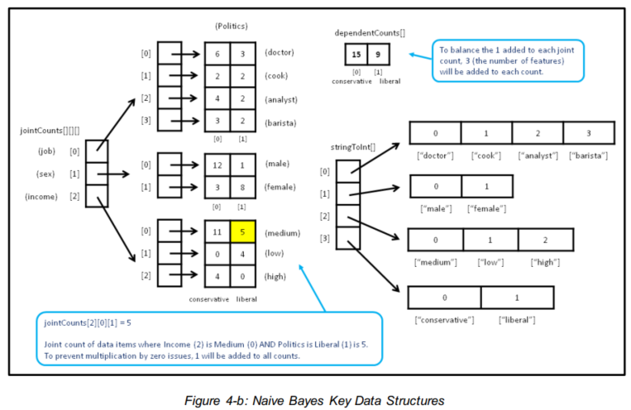
Chapter 4 : Naive Bayes Classification
Defining the BayesClassifer Class :
The structure of the program-defined class BayesClassifier is presented in Listing 4-b. The class has three data members and exposes four public methods. The key to understanding the implementation so that you can modify it if necessary to meet your own needs, is to understand the three data structures.
The class data structures are illustrated in Figure 4-b.

Slide 32
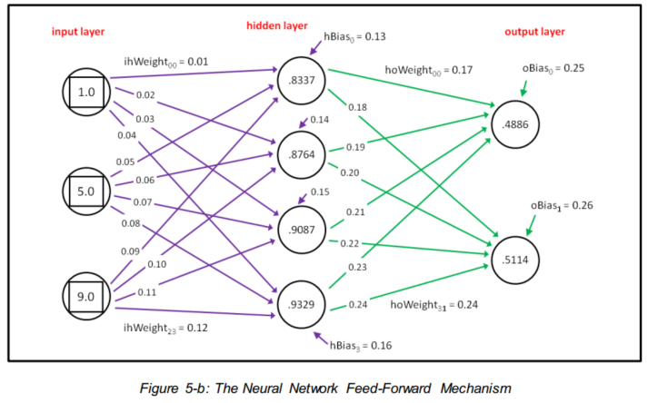
Chapter 5 : Neural Network Classification
each output node is computed in a similar way. Preliminary output values for all nodes are computed, and then the preliminary values are combined, so that all output node values sum to 1.0. In Figure 5-b

Slide 33
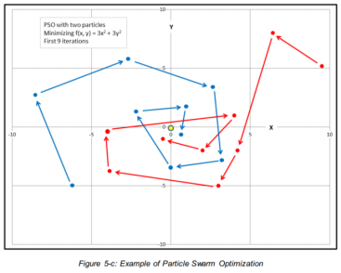
Chapter 5 : Neural Network Classification
Understanding Particle Swarm Optimization
The most common technique to train neural networks is called back-propagation. Back-propagation is based on classical calculus techniques, and is conceptually complex, but relatively simple to implement. The major disadvantage of back-propagation is that it requiresyou to specify values for two parameters called the learning rate and the momentum. Back-propagation is extraordinarily sensitive to these parameter values, meaning that even a tiny change can have a dramatic impact. Particle swarm optimization (PSO) also requires parameter values, but is much less sensitivethan back-propagation. The major disadvantage of using PSO for training is that it is usually slower than using back-propagation.

Slide 35
Introducing
Data structure is a way that how to store, organize sequence data, systematic data can be used effectively.
It starts with having a way to express and compare their relative costs.

Slide 36
Asymptotic Analysis
Constant – O(1)
The size of the input does not influence the time the operation takes.
public int GetCount(int [ ] items)
{
return items.Length;
}

Slide 37
Asymptotic Analysis
Linear – O(n)
An O(n) algorithm is one whose complexity grows linearly with the size of the input
public long GetSum(int [ ] items)
{
long sum = 0;
foreach (int i in items)
{
sum += i;
}
return sum;
}

Slide 38
Asymptotic Analysis
Logarithmic – O(log n)
An O(log n) algorithm is one whose complexity is logarithmic to its size
Ex: Merge sort, Quick Sort

Slide 39
Asymptotic Analysis
Quadratic – O(n²)
An O(n²) algorithm is one whose complexity is quadratic to its size
Ex: Merge sort, Quick Sort

Slide 40

Linked List
- The purpose of a linked list is to provide a consistent mechanism to store and access an arbitrary amount of data. As its name implies, it does this by linking the data together into a list.
- A node is a container that provides the ability to both store data and connect to other nodes.

Slide 41
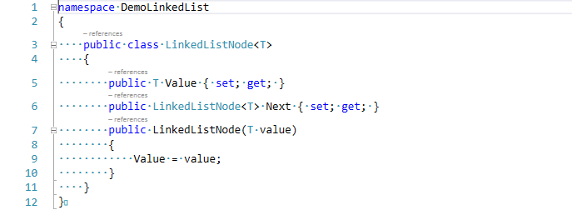
Linked List
LinkedListNode Class

Slide 42
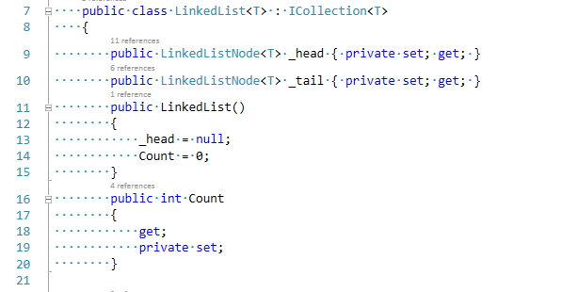
Linked List
LinkedList Class

Slide 43
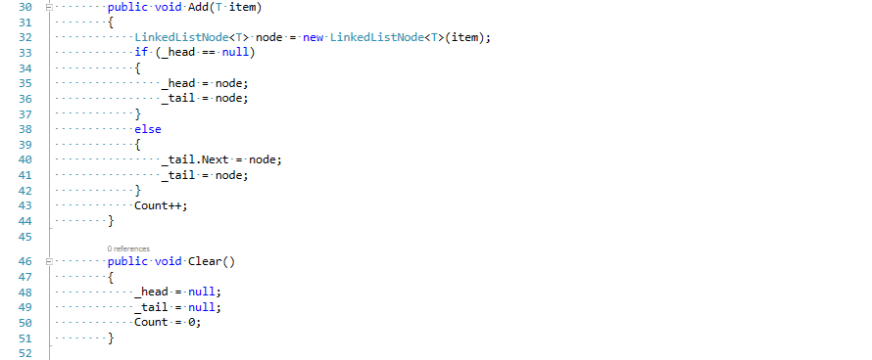
Linked List
LinkedList Class

Slide 44
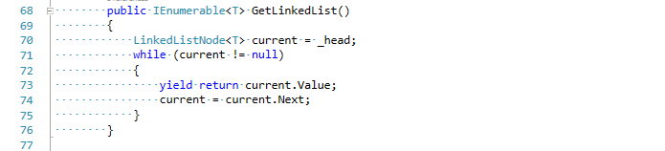
Linked List
LinkedList Class

Slide 45
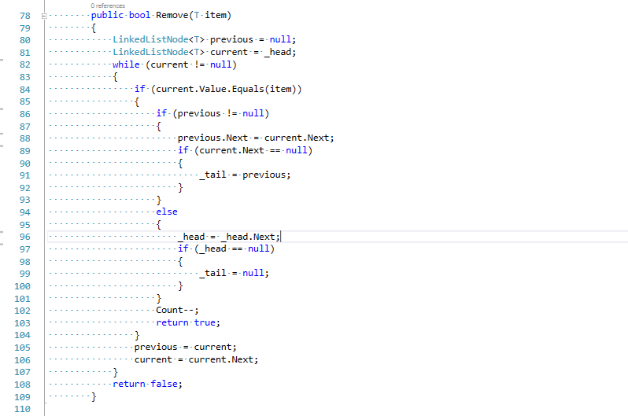
Linked List
LinkedList Class

Slide 46
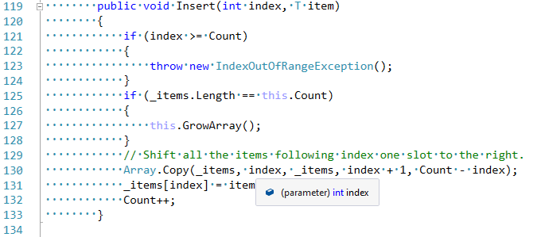
Array List
- ArrayList is a collection that implements the IList<T> interface but is backed by an array rather than a linked list. - Methods of Array List:
Insert

Slide 47
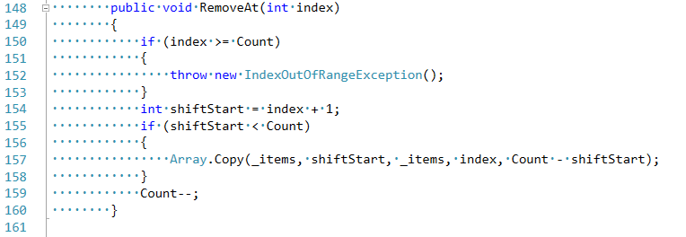
Array List
RemoveAt

Slide 48
Stack
A stack is a collection that returns objects to the caller in a Last-In-First-Out (LIFO) pattern.
Methods of Stack:
Push (Adds an item to the top of the stack.)
Pop (Removes and returns the last item added to the stack. If the stack is empty,an InvalidOperationException is thrown.)
Peek (Returns the last item added to the stack but leaves the item on the stack. If the stack is empty, an InvalidOperationException is thrown.)

Slide 49
Queue
Queues are a First-In-First-Out (FIFO) collection.
Methods of Stack:
Enqueue (Adds an item to the end of the queue.)
Dequeue (Removes and returns the oldest item from the queue. An InvalidOperationException is thrown if the queue is empty.)
Peek (Returns the next item that would be returned if Dequeue were called. The queue is left unchanged. An InvalidOperationException is thrown if the queue is empty.)

Slide 50
Binary Search Tree
A tree is a data structure where each node has 0 or more children
A binary search tree uses the same basic structure as the general tree shown above.
These rules are:
1. Each node can have 0, 1, or 2 children.
2. Any value less than the node’s value goes to the left child (or a child of the left child).
3. Any value greater than, or equal to, the node’s value goes to the right child (or a child thereof)

Slide 51
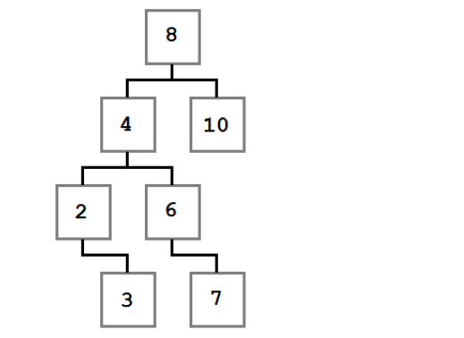
Binary Search Tree
Binary Search Tree

Slide 52
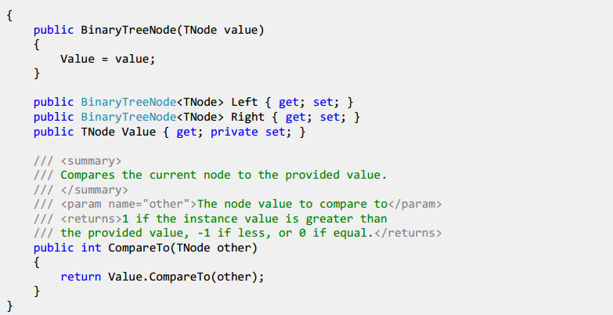
Binary Search Tree
Structures of BinaryTreeNode Class

Slide 53
Binary Search Tree
- Methods of BST:
Add() - Adds the provided value to the correct location within the tree.
Remove() - Removes the first node found with the indicated value.
- Cases of removing a node:

Slide 54
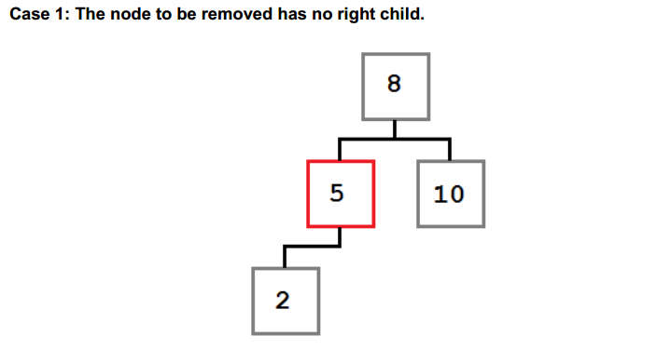
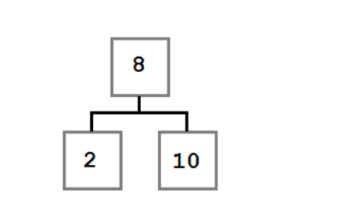
Binary Search Tree

Slide 55
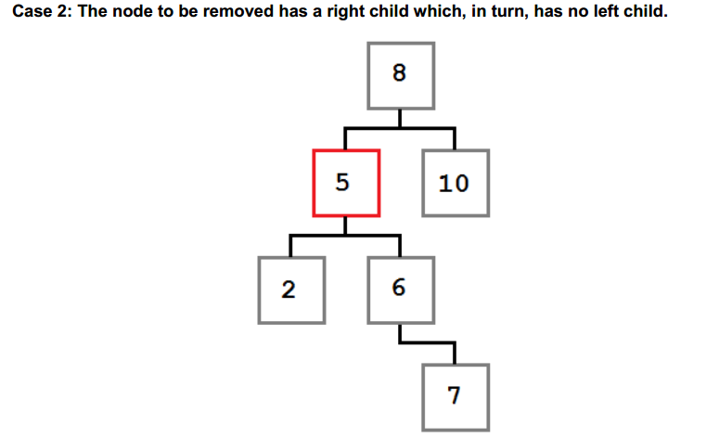
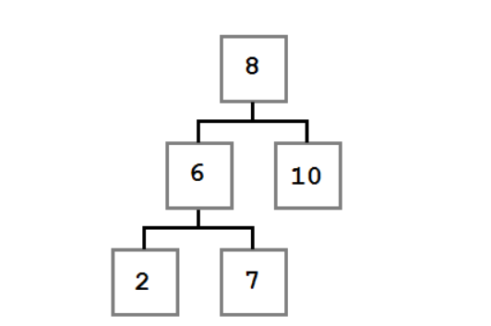
Binary Search Tree

Slide 56
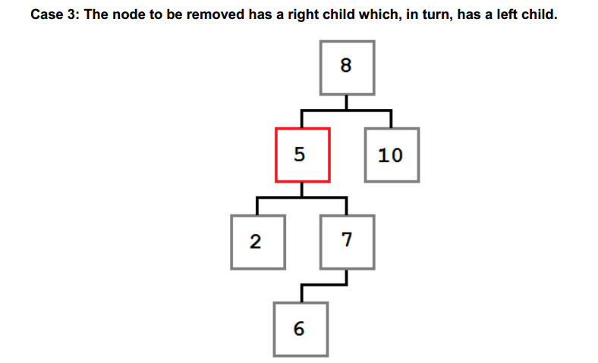
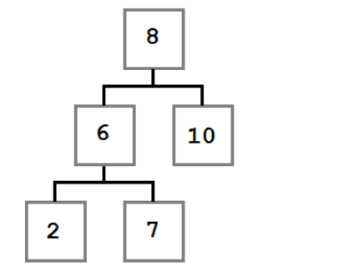
Binary Search Tree

Slide 57
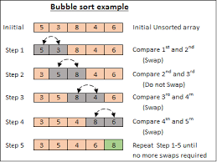
Sorting Alogithms
Bubble Sort: Bubble sort is a naive sorting algorithm that operates by making multiple passes through the array, each time moving the largest unsorted value to the right (end) of the array

Slide 58
Sorting Alogithms
Insertion Sort: Insertion sort works by making a single pass through the array and inserting the current value into the already sorted (beginning) portion of the array. After each index is processed, it is known that everything encountered so far is sorted and everything that follows is unknown.

Slide 59
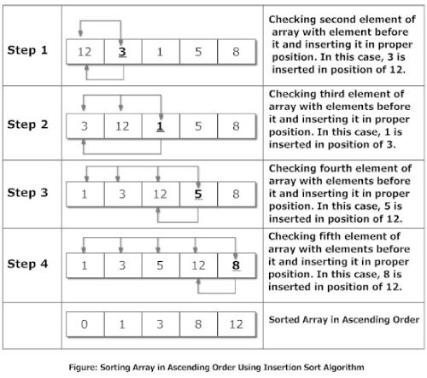
Sorting Alogithms

Slide 60

Sorting Alogithms
Merge Short: Merge sort operates by cutting the array in half over and over again until each piece is only 1 item long. Then those items are put back together (merged) in sort-order.

Slide 61

Sorting Alogithms
Quick Short: is very effective, very common and runtime of the application about O(nlogn)

Slide 62
WPF

Slide 63
Introducing
Windows Presentation Foundation (WPF) is a next-generation presentation system for building Windows client applications with visually stunning user experiences.

Slide 64

Inside WPF
XAML
Extensible Application Markup Language, or XAML (pronounced "zammel"), is an XML-based markup language developed by Microsoft.

Slide 65
WPF Controls Overview
WPF controls
The default WPF control types are: Button, Text, Shapes, Containers, Media, Toolbar, Scrolls, Panels and lists, Miscellaneous.
Grid, DockPanel, WrapPanel, Canvas
Animation
Type Converters

Slide 66
WPF Applications
Navigation: WPF applications can be designed to use a more navigation-based user interface much like a website. To accomplish this design, you will generally use pages instead of window objects.
Data binding: Data binding is a process that establishes a connection between the application UI and the business logic.
DataContext: The DataContext property is the most common way to define the source of a data-binding expression.
MultiBinding:

Slide 67

WPF and MVVM

Slide 68
WPF Commands
The button control, as well as other WPF controls, have a property called Command. This property allows a developer to specify an instance of an implementation of the ICommand interface to accomplish a specified task without adding any code to the Window's code behind.

Slide 69
Advanced WPF Concepts
Property value inheritance
Routed events
WPF documents

Slide 70
WPF Control Styles and Templates
The frameless window effect
Logical tree vs. visual tree
Triggers
Data templates

